Slide 1


The Role of a Data Scientist
Anish Mahapatra | 17 February, 2021

Slide 2

Agenda
01
Introduction
02
Why choose Data Science?
03
What is Data Science?
04
Roles in Data Science
05
Move into Data Science
06
Tools & Technologies
Notes:
Expertrons Company Profile: Valuation & Investors | PitchBook

Slide 3











Topic 1 of 6
Introduction
Senior Data Scientist
LinkedIn: www.linkedin.com/in/anishmahapatra Medium: anishmahapatra.medium.com Website: www.anishmahapatra.com
GitHub: www.github.com/anishmahapatra
Q. How to get into Data Science?
A. Simple, ask a real-world Data Scientist.

Slide 4




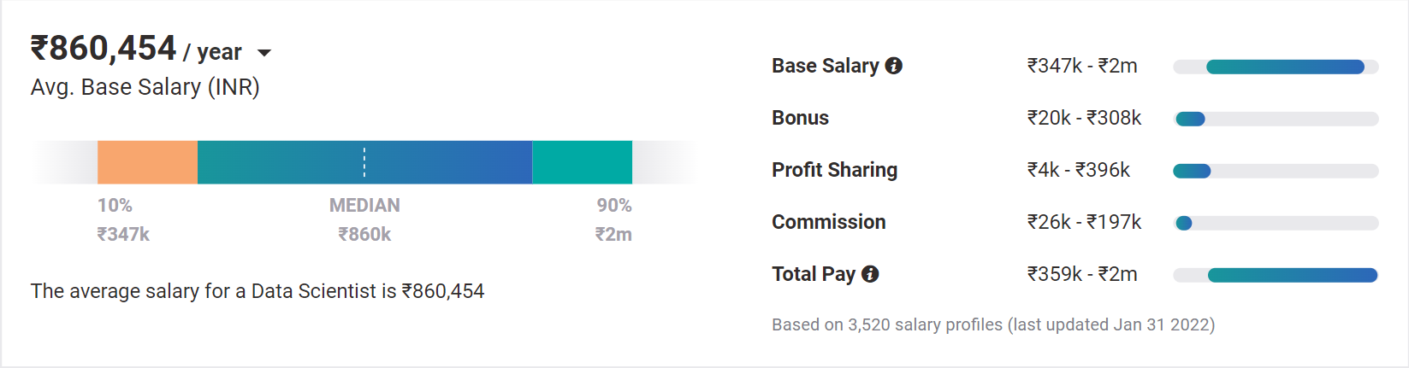
Topic 2 of 6
Why choose Data Science?
01
02
03
Relevance in the future
Business & Technology
Industry-Agnostic
Companies are building and growing in Data and it is the future.
Data Science is a combination of Business, Math and Technology, so growth can be in business / technology
Use your existing knowledge / domain / technology expertise with a data-edge
04
Extremely High Market Demand
Supply-Demand mismatch means companies are willing to pay more
Notes:
Source:https://www.payscale.com/research/IN/Job=Data_Scientist/Salary

Slide 5
Topic 3 of 6
What is Data Science?
01
02
03
Data Access
Data Silos to Data Warehouse
Data Analytics & Modelling
Identify List of Data Owners,
Request Access,
Maintain Single POC,
Understand current process
Exploratory Data Analysis,
Business Analytics,
Heuristic, Statistical & ML Models.
Experimentation
Make Data Dictionary,
Set up Data pipelines, Make ER Diagram, Main Analytical Data frame
06
05
04
Business Decisions, Impact Analysis
Data Visualization & Dashboarding
Feature Engineering
Building new features, Combining external data, Building a feature store
Model Evaluation, Monitoring Model Performance and Drift, Data Governance Policies
Dashboards to aid decision-making,
Decide concurrency, cadence and security

Slide 6



Topic 4 of 6
Roles in Data Science
01
02
03
Data Engineer
Machine Learning Engineer
Business Analyst
Data Movement, Building Data pipelines, Quality of Data, Data Governance
Experimentation to get output, Modelling, Making the most out of data, Data Analytics
Client communication & management, Dashboarding & Reporting, Visualization, Decision Making
04
Data Scientist
Data on the cloud, modelling in all capacities, visualization, presentation to stakeholders, team management
Notes:
Source: https://databricks.com/blog/2020/08/03/modern-industrial-iot-analytics-on-azure-part-1.html

Slide 7
Topic 5 of 6
How to move into Data Science
01
02
03
Set Target
Talk to people
Build LinkedIn Profile
Understand the Data Field,
Understand roles & responsibilities,
Look at a 5-year path
Talk to people who are already doing what you want to do
Add certifications, participate in competitions, do simple projects, look at how the best of the best do it
06
05
04
Build Collaterals & Profile (30%)
Globally Accepted Degree (70%)
Explore Certifications
Multiple certifications don’t help, the quality of it does.
GitHub, LinkedIn,
Medium, Brand Profiling
Globally recognized degree, Degree Accepted by MNCs,
Possibility of PhD later,
Alumni Status
Bonus - WES Certification, Teachers from the industry
Notes:
Source: https://databricks.com/blog/2020/08/20/modern-industrial-iot-analytics-on-azure-part-3.html

Slide 8












Topic 5 of 6
Tools & Technologies in Data Science
Data Engineer
Machine Learning Engineer
Business Analyst
Data Scientist

Slide 9





Topic 5 of 6
Resume Optimization (Demo)

Slide 10
Key Takeaways
01
Introduction - Anish Mahapatra
02
Why choose Data Science? - Be relevant in the future
03
What is Data Science? - Understand end to end
04
Roles in Data Science - DE, MLE, BA, DS
05
Move into Data Science - Detailed Steps to move into DS
06
Tools & Technologies - Defined for the various roles
Notes:
Expertrons Company Profile: Valuation & Investors | PitchBook

Slide 11

Career Road Map in Data Science
Anish Mahapatra
Q&A Session
LinkedIn: www.linkedin.com/in/anishmahapatra
Email: anishmahapatra01@gmail.com

Slide 12
Topic 1 of 6
Introduction
Senior Data Scientist
LinkedIn: www.linkedin.com/in/anishmahapatra Medium: anishmahapatra.medium.com Website: www.anishmahapatra.com
GitHub: www.github.com/anishmahapatra
Q. How to get into Data Science?
A. Simple, ask a real-world Data Scientist.

Slide 13
Career Road Map in Data Science
Anish Mahapatra | 8 November, 2021
Q. How to get into Data Science?
A. Simple, ask a real-world Data Scientist.
Email: anishmahapatra01@gmail.com
Thank you.

